Slide 2
ISPyB DB Meeting
ISPyB Collaboration
Alex de Maria Antolinos
Software Engineer
Data Manager@Data Analysis Unit
On Behalf of
Software Group
Structural Biology Group
ESRF

Slide 3
OUTLINE OF TALK
Quick review of the MOU
Some clarifications
Homework
Lessons learnt

Slide 4
MOU: What does it say?
ARTICLE 1: Objective of the Collaboration
[...]
It includes the development of the ISPYB software (data model definition, the database structure, and the API layer to access data stored in the database).
[...]
ARTICLE 3: Collaboration Membership
Membership of the Collaboration is obtained by signing this Agreement. In signing the Agreement, each Party undertakes to contribute the manpower required to enable the active, on-going development of ISPYB data model, API layer to access data stored in the database and functionalities to the maximum benefit of all parties.

Slide 5
MOU: What does it say?
ARTICLE 6.1: Data Model, Database and API layer to access data
Any change in the technology used to implement ISPYB database (MySQL, MariaDB and Oracle are currently supported) and API layer to access the data (JAVA/JEE/ejbs, webservices), the server part running on JBoss server, will be discussed and agreed between members of the Developers Committee.
ARTICLE 6.2: Web application
The ISPYB web applications are developed with Java/JEE and javascript technologies, running on a JBoss application server, and support both MySQL and Oracle databases.
Although common user interfaces would make ISPYB easier to operate and maintain, the Parties are free to develop their own set of interface pages using a different technology, but these will not be supported via the Collaboration, unless this is agreed by the STC
ARTICLE 6.3: ISPyB Repository
At any given time, there will be only one official version of the ISPYB software, available through a publicly accessible web site for download and collaborating on source code. Currently, the URL is http://forge.epn-campus.eu, and the ISPYB source code repository is http://forge.epn campus.eu/projects/ispyb4/repository.

Slide 6
Clarification 1
ISPyB is a Software
(not a database)
It is written in JAVA (~120k lines of JAVA code)
It uses a relational database that is called pydb
It is deployed in a application server called JBoss

Slide 7
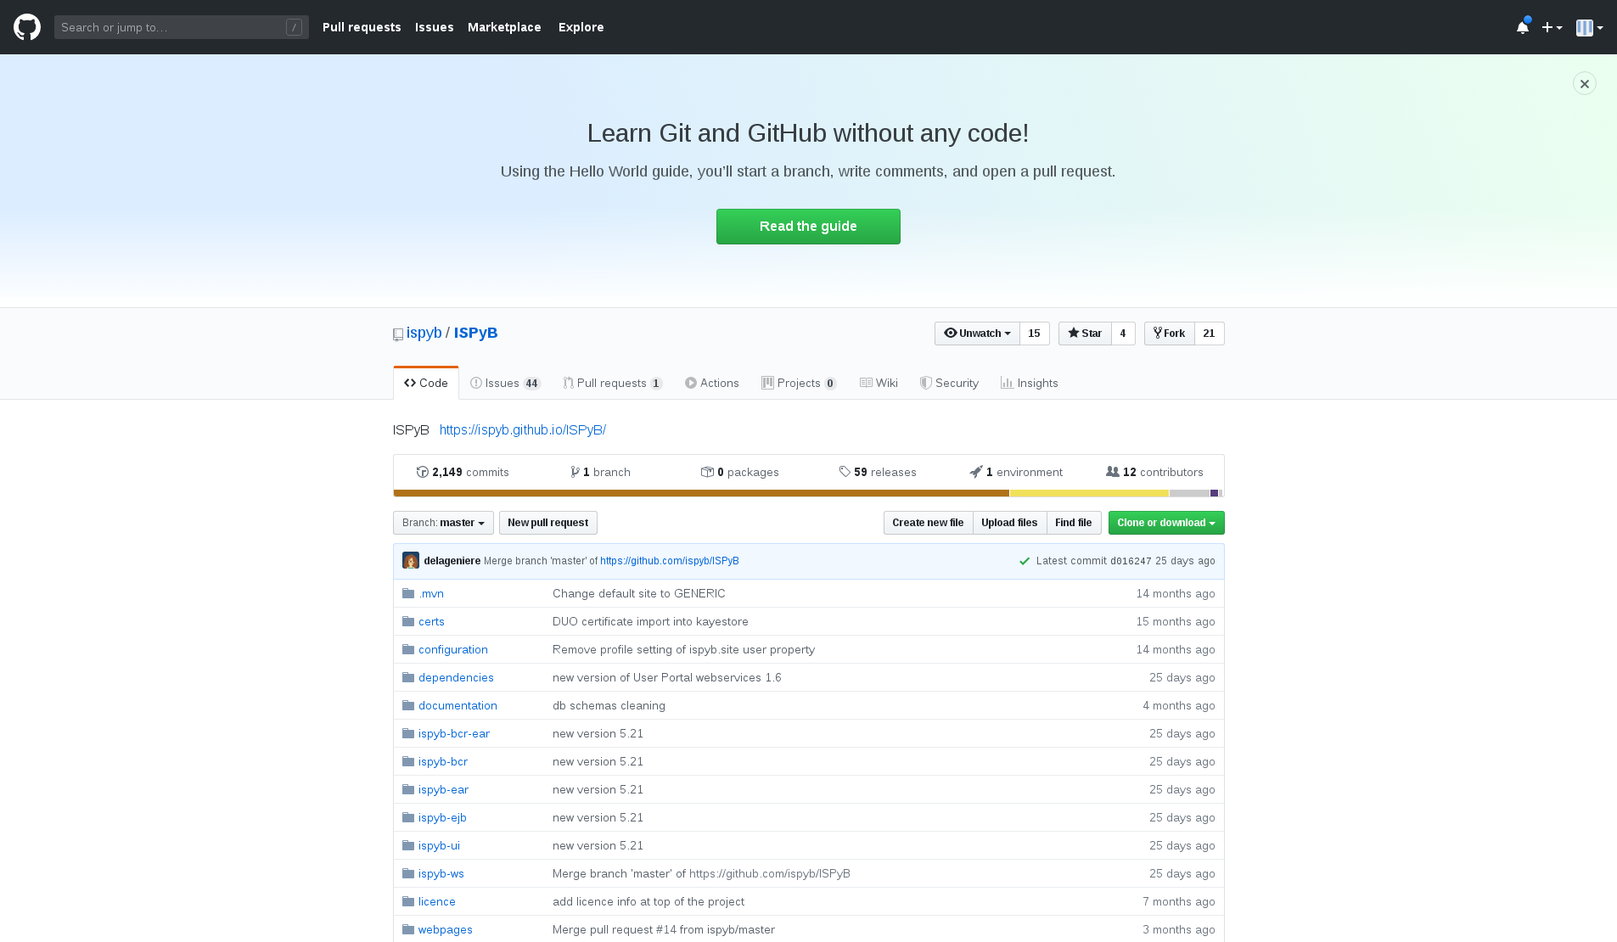
Clarification 2
ISPyB code is on Github
https://github.com/ispyb/ispyb

Slide 8
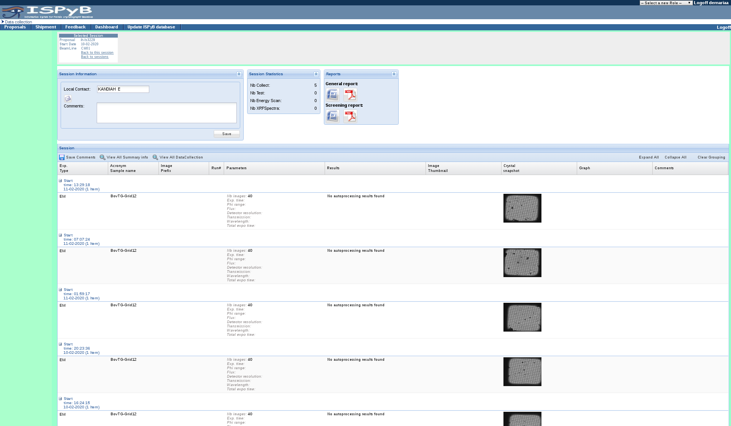
Clarification 3
ISPyB has got an old User Interface
That UI is deprecated and not maintained since 2016 (2017?)

Slide 9
HOMEWORK
Preparation of this meeting:
Enquiry sent to the collaborators
Interview with scientists (ESRF and EMBL grenoble)
They are users of both Synchweb and ISPyB
A ESRF ISPyB board meeting with:
Head of Structural Biology Group (Gordon)
Head of the Software Group (Andy)
ISPyB Developers (Solange, Olof, Maxime and myself)
Synchweb author (Stuart Fisher)

Slide 10
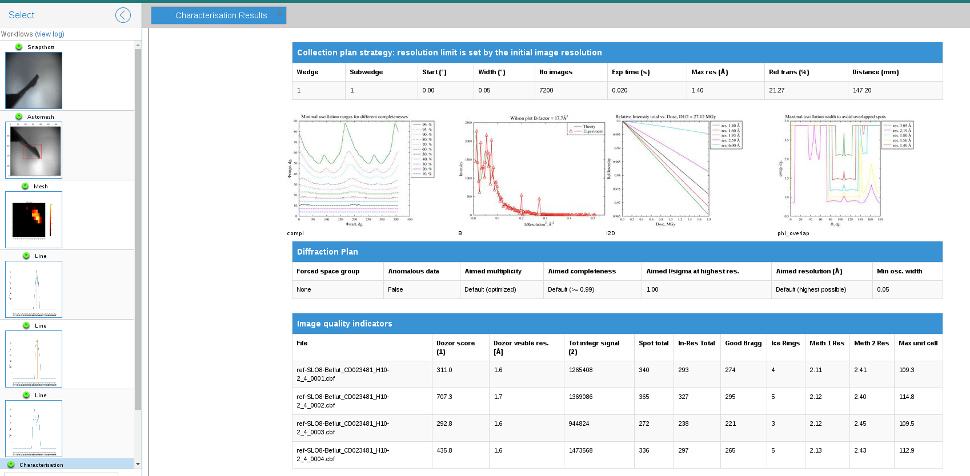
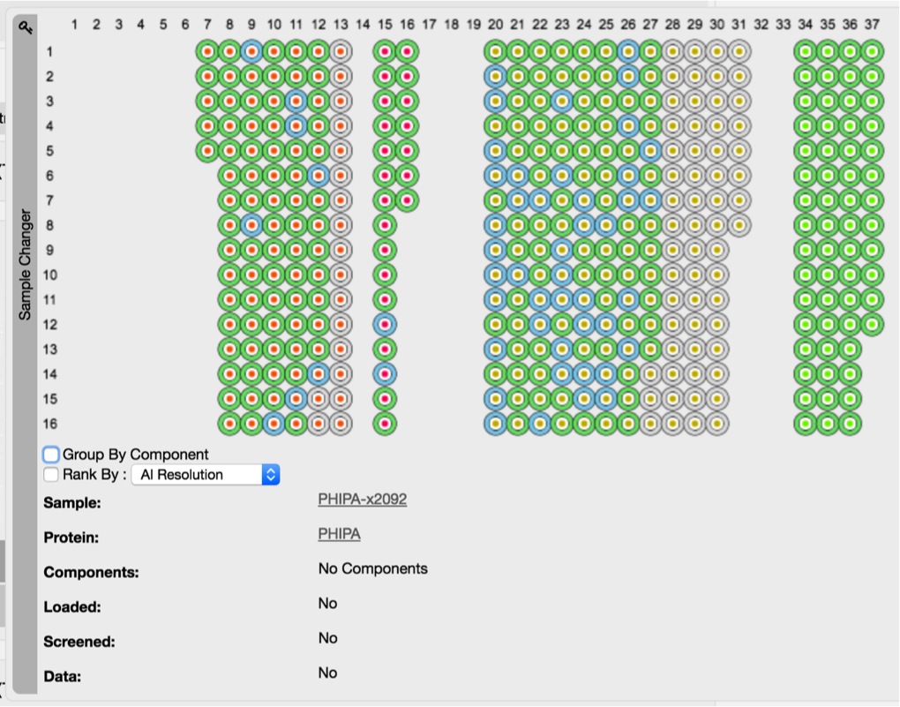
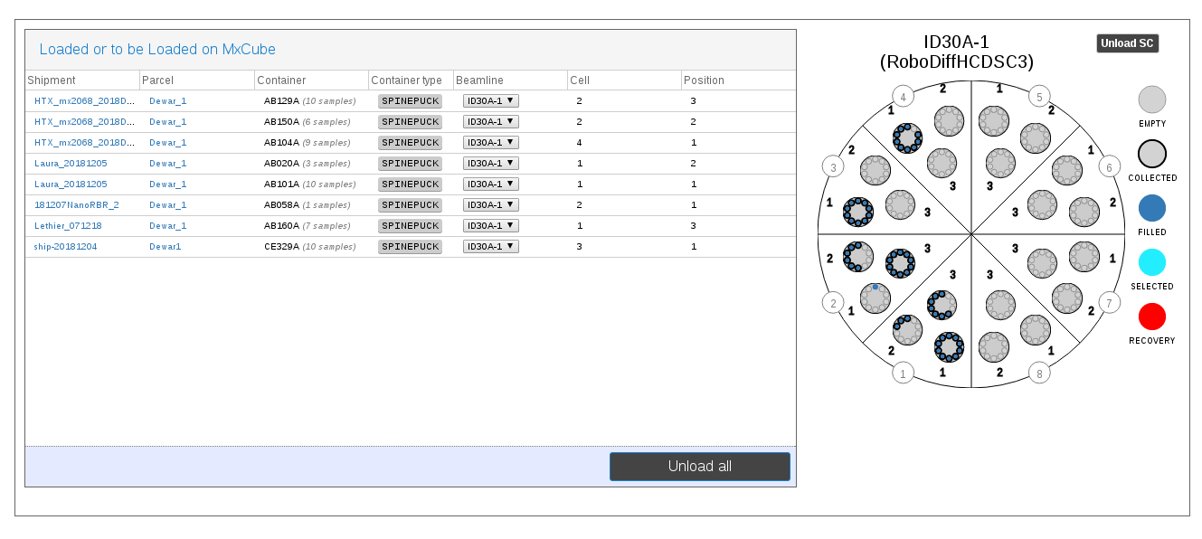
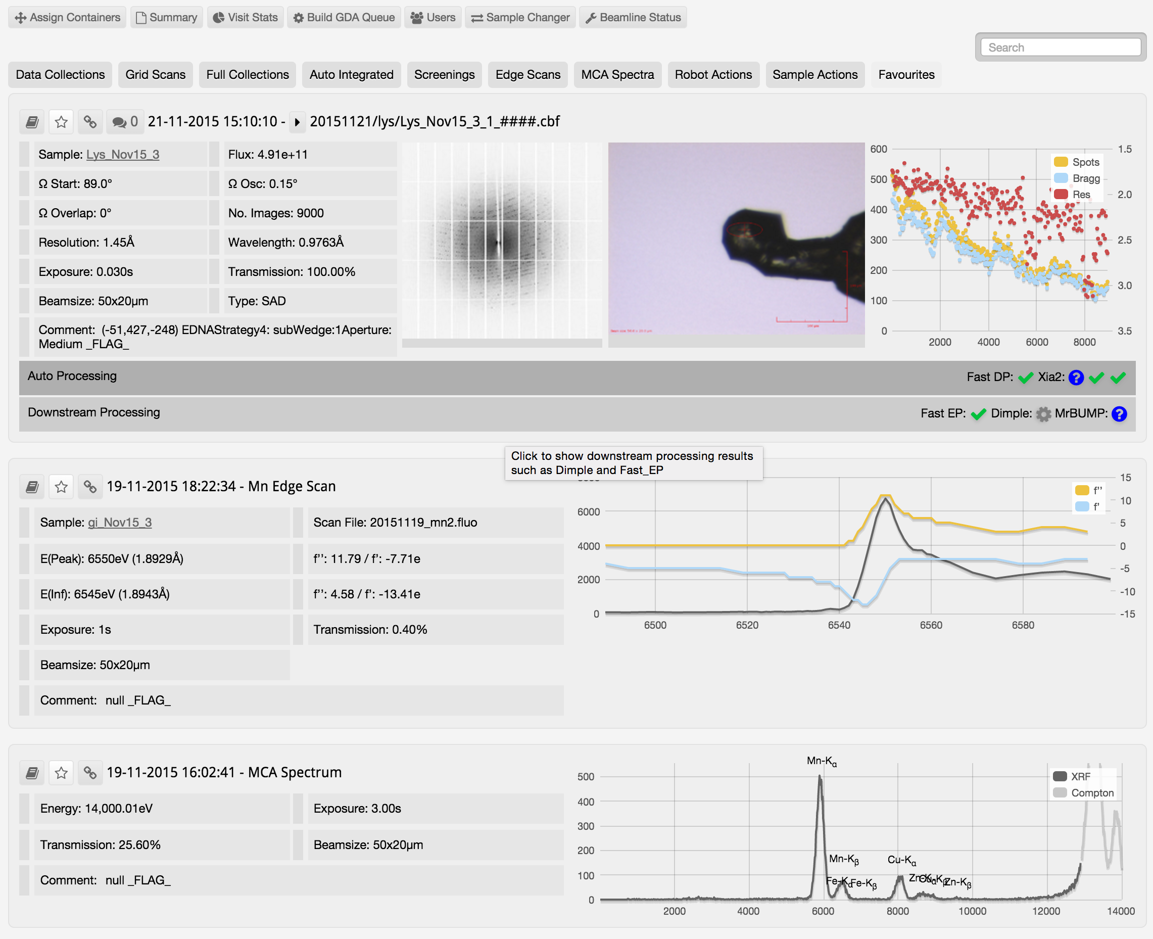
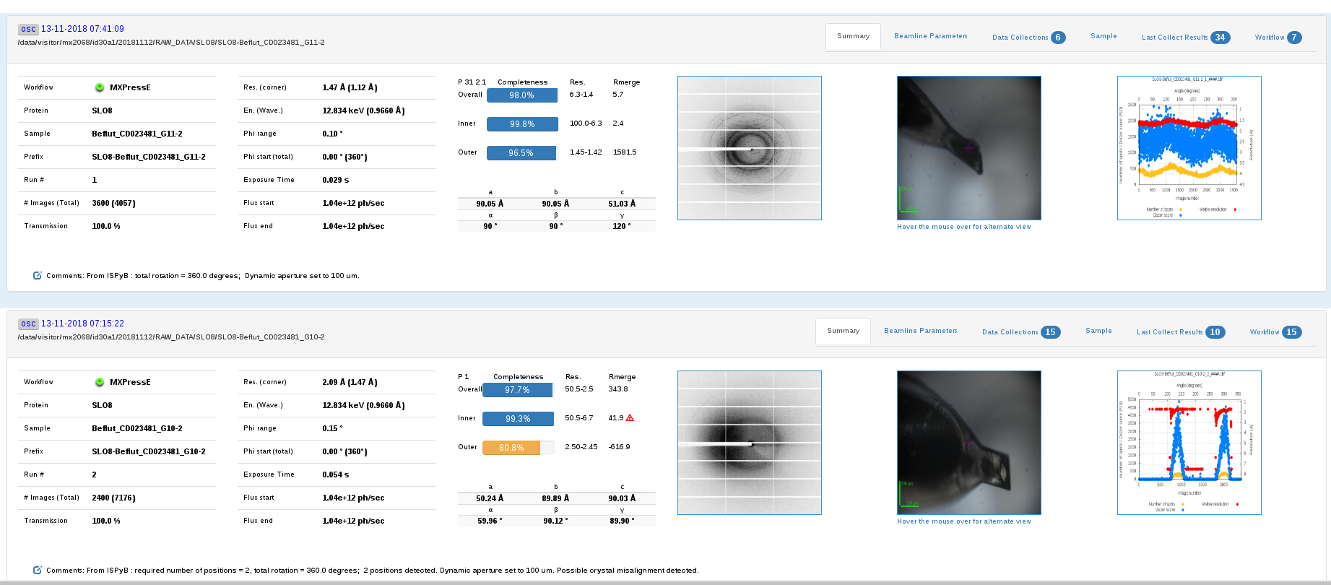
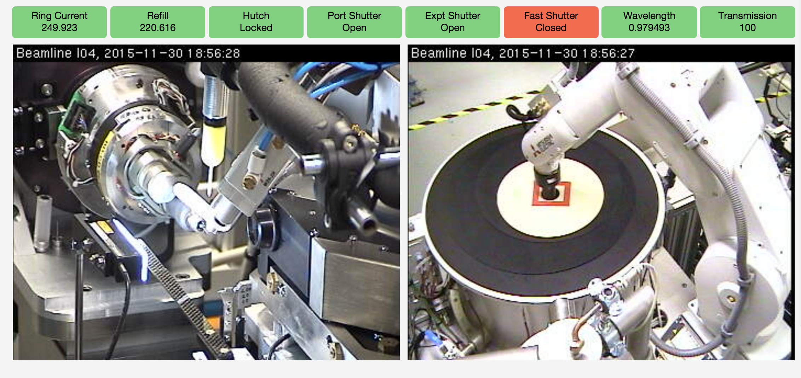
Interview with Scientists
Evaluation on MX side only:
Bottom line is:
EXI and Synchweb are similar
Data is displayed in a slightly different way
Same speed
ISPyB (+EXI)
Workflows
Better SC integration
SynchWeb
Better managements stats
DHL API

Slide 11
ESRF ISPyB Board Meeting
Bottom line is:
We need to find a way to collaborate all together
Considering all options:
All partners to use ISPyB (not in our hands)
Use Synchweb at the ESRF
Estimation of costs (see details later)
Disadvantages
There is no PHP expertise at the ESRF (in any Synchrotron?)
Front-end of SynchWeb uses a obsolete framework (Marionette)
SynchWeb might be at the end of his life (?)
Decentralized architecture
Start a new software (or consider one existing) that will replace ISPyB and Synchweb

Slide 12
Estimation of moving to Synchweb at the ESRF
Technique | Task Description | Cost Estimation(days)
 |  | Synchweb | Using python api | Additional for new webservice
BioSAXS | Develop a backend that allows to store HPLC and sample Changer experiments |  | 30 | -
BioSAXS | Develop an API in SynchWeb for BioSAXS | 80
BioSAXS | Develop a UI on Synchweb for BioSAXS | 120
EM | Develop a backend that allows to store EM experiments for single particle |  | 10 | 2
EM | Check and/or adapt existing EM UI |  | 1
MX | Develop a backend that allows to store Data collections (EnergyScan and XRF) |  | 10 | 2
MX | Develop a backend that allows to store Workflows |  | 10 | 2
MX | Develop a backend that allows to store Autoprocessing |  | 10 | 4
MX | Check and adapt if necessary existing UI (Example: display workflows) |  | 5
MX | Make available Synchweb features at the ESRF (Example: robot actions) |  | 2
SMIS | Synchronization SMIS-Synchweb |  | 5 | 2
Data confidentiality | Develop the webservices that triggers the data confidentiality |  |  | 2
 | TOTAL | 200 | 83 | 14
~ 1.5 year of work
Estimation done by Stuart

Slide 13

ISPyB or SynchWeb?
ISPyB
Synchweb

Slide 14
ISPyB or SynchWeb?
none of them?

Slide 15
A new software?
Nothing can be done at short term BUT we can try to collaborate in a new software
Microservices?
Based on modules
Which techniques?
Relational or NO-SQL database?
A fresh non-MX centric data model
Python, JAVA, other?
Explore available options
New Software
Adapt a existing software
ESRF would be interested in participating in the development of a Pilot module on Sample description and tracking

Slide 16
Enquiry
 |  | ESRF | DLS | SOLEIL | MAXIV | ALBA | EMBL
Man power
 | FTEs | 1.5 | 3.5+ | 0.5 | 0.5 | 0.5 | 0.5
Current Installation
 | Frontend [ISPyB | EXI | SynchWeb] | EXI ISPyB EXI2 | SynchWeb | ISPyB | ISPyB EXI | ISPyB | ISPYB, EXI, SynchWeb
 | BackEND [ ISPyB | SynchWeb ] | ISPyB | SynchWeb | ISPyB | ISPyB | ISPyB | ISPYB, Synchweb, ispyb-api
Functionality |  |  | ispyb-api (python & java)
 | Techniques to support | MX, TR-MX, BioSAXS EM | MX EM XPDF Powder + | MX, BioSAXS | MX | MX | MX, TR-MX, XRI
New start
 | Preferred list of programming languages | Python NodeJS JAVA | Python | NodeJS, Java | Python, NodeJS | Python, NodeJS, Java | any
 | Preferred list of DB engines | Mongo Maria Oracle | MariaDB, Postgres? | MariaDB, Oracle, Postgres | Maria, Postgres | Maria, Mongo | any
 | Preferred list of API | REST GraphQL | REST, GraphQL | REST, GraphQL | GraphQL, REST | REST, GraphQL | REST

Slide 17
Lessons learnt
We need a developers committee that takes technical decisions
Same format as the steering committee (1 site = 1 vote and depend on their contribution)
Steering committee to provide resources
Scope of the application should be perfectly defined beforehand and not a moving target
1 decision might involve many months of work, i.e.: add techniques to ISPyB
Full stack should be included or at least ESRF is interested in looking for partners that will work together in the full stack (it includes UI)

Slide 18
Possible road map for the collaboration
X
New software
WG on ISPyB/EXI
New Software
microservices
Devs on ISPyB/EXI
reprocessing
WG on microservices
database
Pilot module: sample tracking
database
Pilot module: sample tracking
database
database
Devs on Synchweb
Web pages
WG on Synchweb
X
...
Feb 2020
June 2020
2021
Future

Slide 19
Possible road map for the collaboration
In a short/medium term
Collaborate on microservices?
Collaborate on new database choice ?
Collaborate on pilot module ?
In the meantime separate working groups on Synchweb / ISPyB/EXI to carry on current developments
In a long term
Collaborate on new software
Drop Synchweb / ISPyB/EXI
Advantages :
concentrate on collaboration for the future, and stop endless discussions about how to force compatibility between ISPyB/synchweb for the current needed evolutions of the datamodel.
Allow quicker short-term evolutions and give more time to new software conception.

